Slide 1

A presentation on “artificial intelligence” by narayana reddy.ch

Slide 2
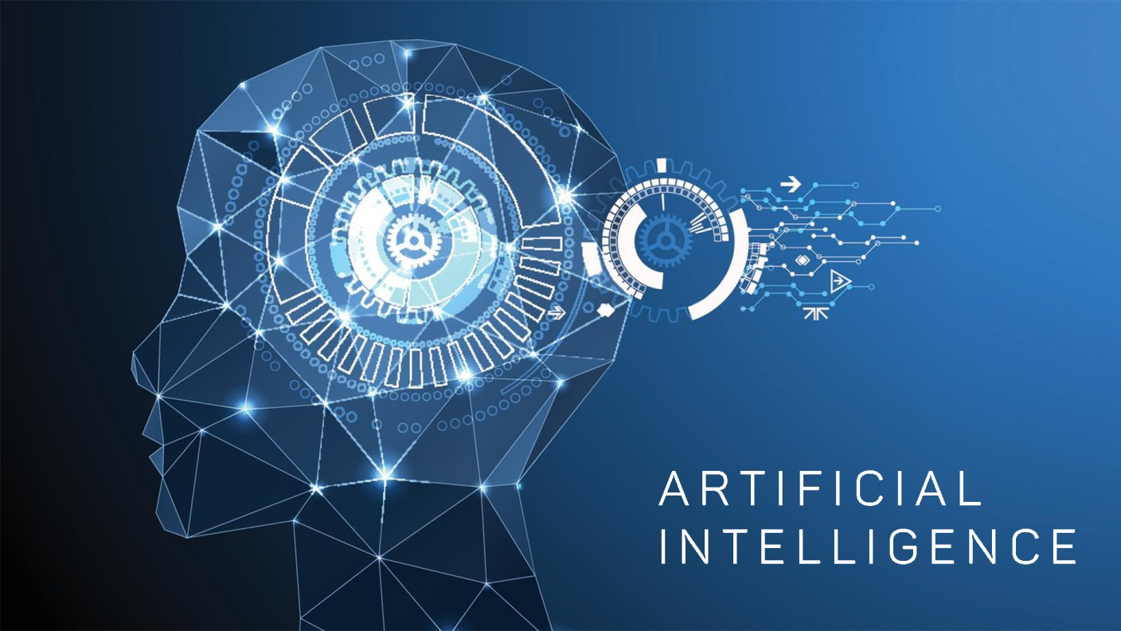
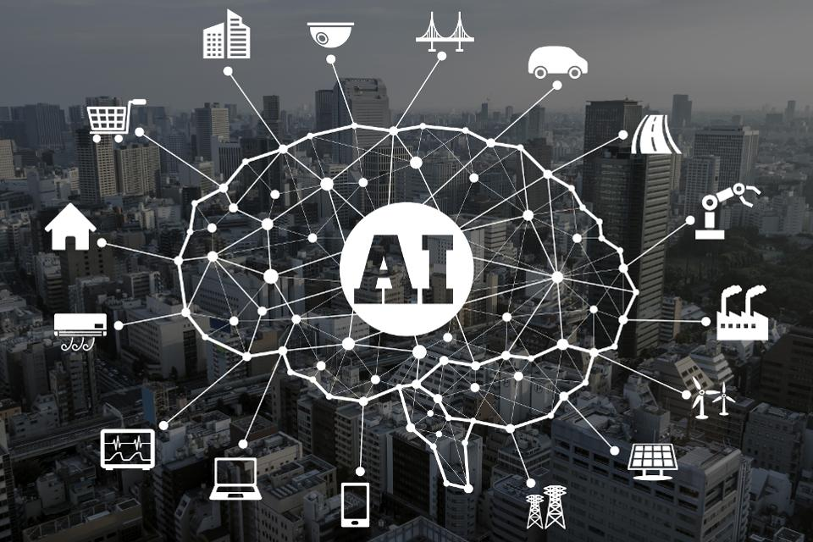

Slide 3

INTRODUCTION
TYPES OF AI
HOW FAR AI IS BETTER THAN NI
ETHICS AND RISKS OF AI

Slide 4
INTRODUCTION TO “ARTIFICIAL INTELLIGENCE”

Slide 5
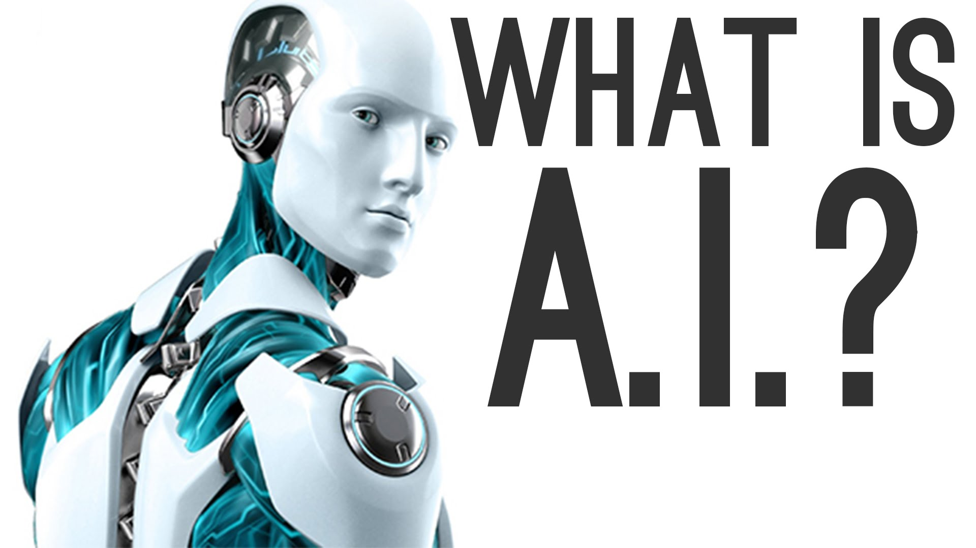

Slide 6
ARTIFICIAL INTELLEGENCE
AI (pronounced AYE-EYE) or Artificial Intelligence is the simulation of human intelligence processes by machines, especially computer systems.
These processes include learning , reasoning , and self-correction.
AI perceives its environment and takes actions that maximize its chance of success at some goal.
Particular applications of AI include expert systems, speech recognition and machine vision.

Slide 7
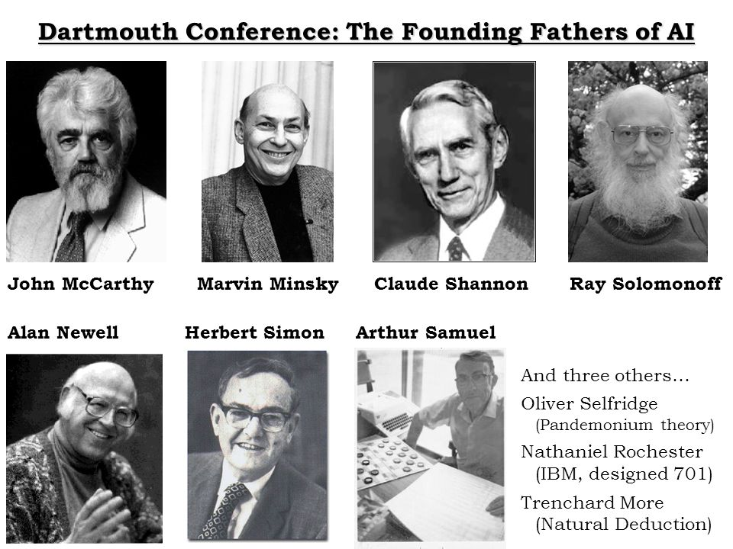
History of AI

Slide 8
Dartmouth conference
John McCarthy coined the term “Artificial Intelligence" in 1955, and organized the famous “Dartmouth Conference” in Summer 1956. This conference started AI as a field.
John McCarthy is one of the "founding fathers" of Artificial Intelligence, together with Marvin Minsky, Allen Newell ,Herbert A.Simon, Arthur samuel,claude shannon and Ray solomonoff.
HERBERT SIMON- predicted that “Machines will be capable of doing Any thing that man can do,within twenty years

Slide 9
Types of Artificial Intelligence
AI mainly categorized into two ways. They are
1.Weak AI
2.Strong AI
Weak AI(narrow intelligence):
Weak artificial intelligence (weak AI), also known as narrow AI, is artificial intelligence that is focused on one narrow task.
Weak AI is defined in contrast to strong AI
EX:- Google assistant, Siri(Apple Inc’s ios)

Slide 10
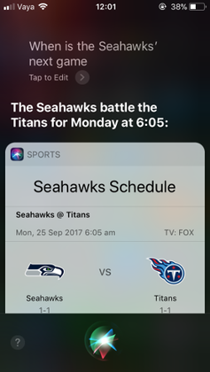
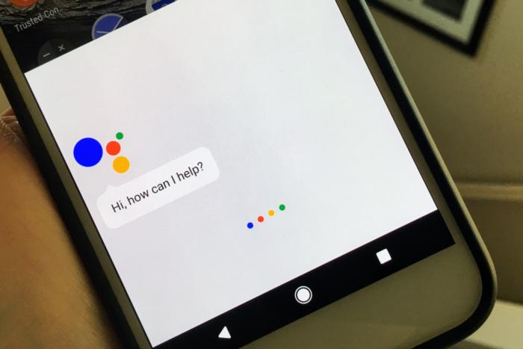
Siri dictates the next fixture for the Seattle Seahawks, upon the user's request, on an iPhone SE running iOS 11

Slide 11
Strong AI(general intelligence):
A strong AI is also known as TRUE AI , Is a hypothetical machine that exhibits behavior as skillful and flexible as humans do.
An it is a system with Generalized human cognitive abilities, so that when presented with an unfamiliar task, it has enough intelligence to find a solution.
According to Computational theory of mind names a view that the human mind or the human brain (or both) is an Information processing system and that thinking is a form of computing.
The theory was proposed in its modern form by Hilary Putnam in 1961, and developed by the MIT philosopher and cognitive scientist Jerry Fodor (who was Putnam's PhD student) in the 1960

Slide 12
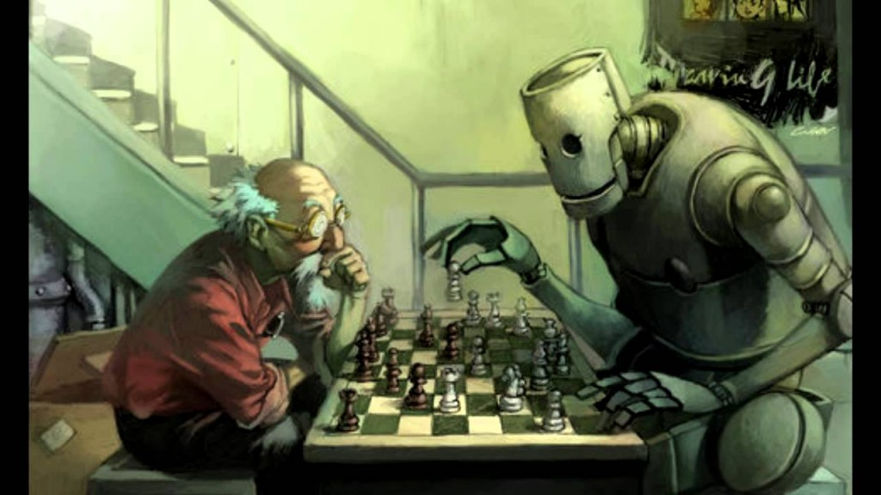
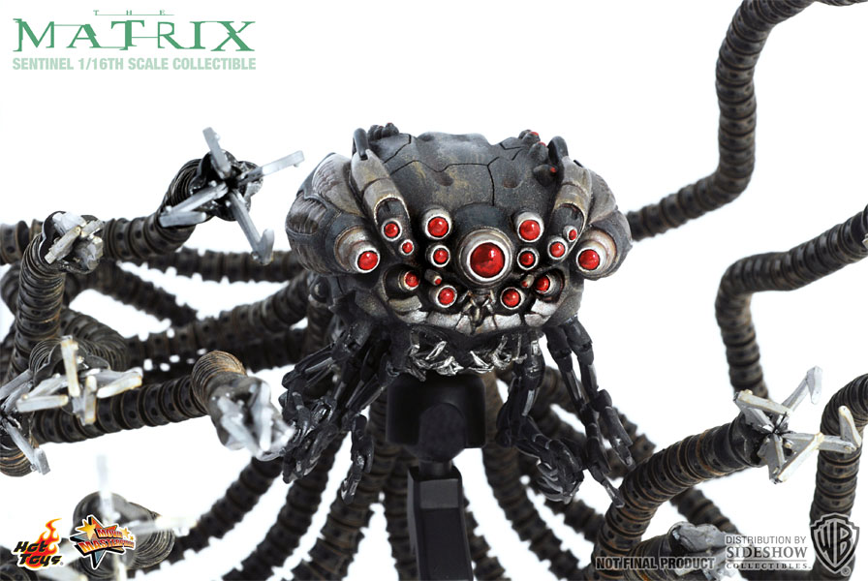
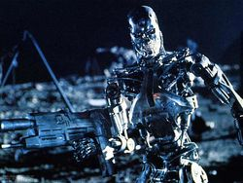
These are the fictional character from the movies MATRIX & TERMINATOR

Slide 13
The second classification is
Type 1: Reactive machines
Type 2: Limited memory
Type 3: Theory of mind
Type 4: Self-awareness
Reactive machine:
The most basic types of AI systems are purely reactive, and have the ability neither to form memories nor to use past experiences to inform current decisions.
This type of intelligence involves the computer perceiving the world directly and acting on what it sees. It doesn’t rely on an internal concept of the world.

Slide 14
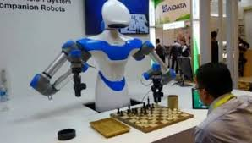
Deep Blue, IBM’s chess-playing supercomputer, which beat international grandmaster Garry Kasparov in the late 1990s, is the perfect example of this type of machine.
Deep Blue can identify the pieces on a chess board and know how each moves. It can make predictions about what moves might be next for it and its opponent. And it can choose the most optimal moves from among the possibilities.

Slide 15
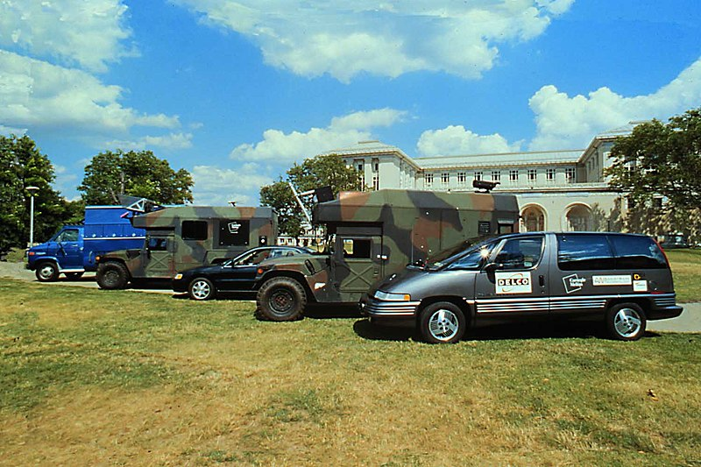
Limited memory:
These AI systems can use past experiences to inform future decisions.
Some of the decision-making functions in autonomous vehicles have been designed this way.
These observations are not stored permanently
Navlab autonomous cars 1 through 5. NavLab 1 (farthest in photo) was started in 1984 and completed in 1986. Navlab 5 (closest vehicle), finished in 1995, was the first car to drive coast-to-coast in the United States autonomously .

Slide 16
Theory of mind:
This is a psychological term.
This AI has capacity to understand thoughts and emotions which affect human behaviour.
These can comprehend feelings, motives,intentions and expectations, and can interact socially- has yet to built, but would likely be the next class of intelligent machines
This kind of AI is in boning stage.
Examples: C-P3o robot and R2-D2 from starwars universe.
Sonny in 2014 film, I-ROBOT

Slide 17
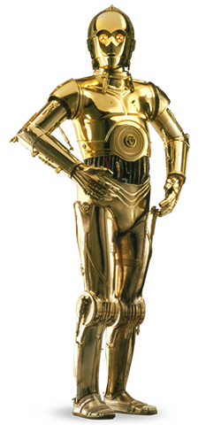
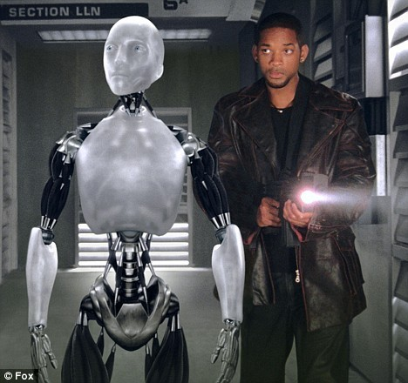
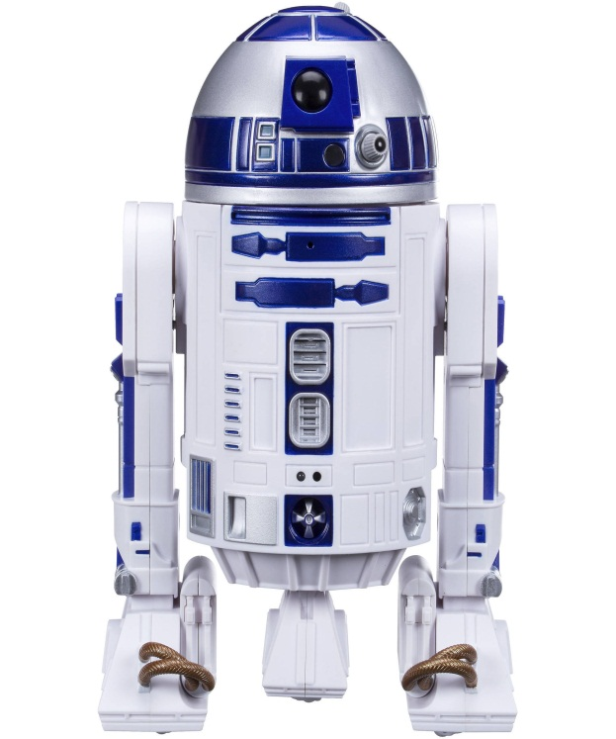
Star Wars characters(1977)- created by george lucas

Slide 18
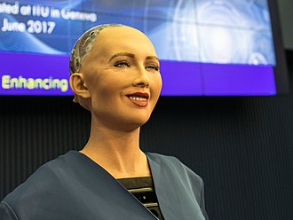
Sophia is a humanoid robot developed by Hong Kong-based company Hanson Robotics.
It has been designed to respond to questions, and has been interviewed around the world.
In October 2017, the robot became a Saudi Arabian citizen, the first robot to receive citizenship of any country.
The software has been programmed to give pre-written responses to specific questions or phrases, like a chatbot These responses are used to create the illusion that the robot is able to understand conversation, including stock answers to questions like "Is the door open or shut?
The information is shared in a cloud network which allows input and responses to be analysed with blockchain technology.
The robot's range of facial expressions are facilitated by its artificial "frubber" skin, which is mechanically manipulated.

Slide 19
Self-awareness:
These types of AI can form representations about themselves.
This is An extension to the theory of mind.
There are aware of their internal states,can predict the feelings of others, and can make abstractions and inferences.
These are future generation of machines: super intelligent, sentient and conscious.
Examples:
Eva in the 2015 movie EX Machina
Synths in the 2015 tv series Humans

Slide 20
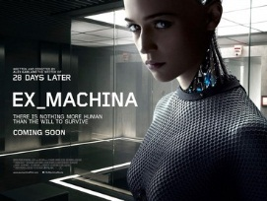
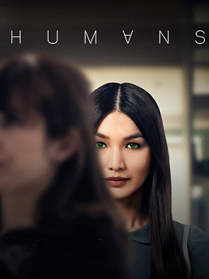

Slide 21

How far AI is better than Human Brain…..?

Slide 22
AI has ability to simulate human behaviour and cognitive process.
Capture and can preserve human expertise.
Faster in response.
AI do not require sleep or breaks, and are able to function at anytime.
They can continuously perform the same task without getting bored or tired.
When employed to carry out dangerous tasks, the risk to human health and safety is reduced.
The chances of error are almost nil and greater precision and accuracy is achieved.

Slide 23
APPLICIOATNS OF “AI”
Electrical engineering (power systems)
Hospitals & medicine ( medical diagnosis, Heart sound)
Electronic trading (NYSC Arca, NASDAQ)
Remote sensing.( geography, land surveying)
Aviation (DARPA)
AI in space exploration.
Game playing.
Finance (algorithmic trading, personal finance)
Heavy industry.
Music (lamus computer cluster)
Online and telephone customer service
Transportation (fuzzy logic)
understanding natural language.
speech recognition.

Slide 24
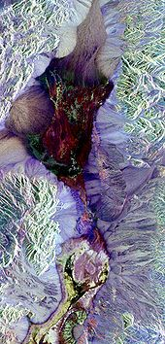
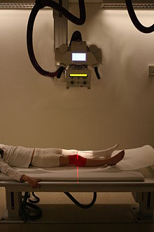
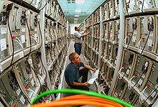
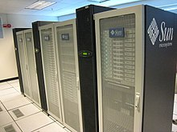
Technicians working on a large Linux cluster at the Chemnitz University of Technology, Germany
Synthetic aperture radarimage of Death Valley colored using polarimetry.
Radiography is an important tool in diagnosis of certain disord
Sun Microsystems Solaris Cluster

Slide 25


An automated online assistant providing customer service on a web page.
In strategy games like Freeciv, the game AI must deal with large amounts of information

Slide 26
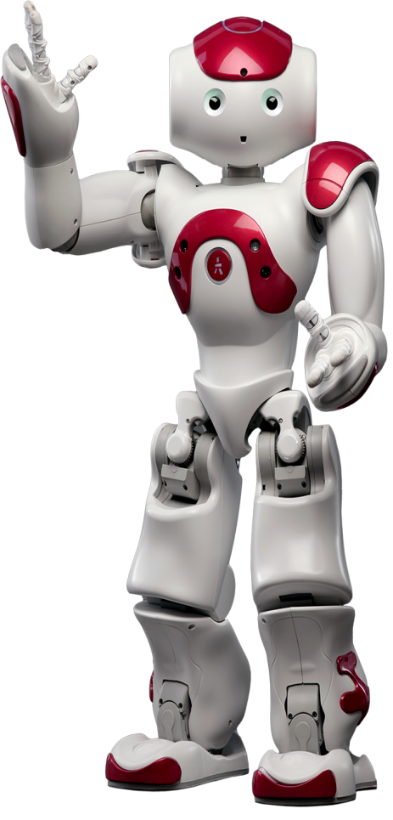
ETHICS AND RISKS O F AI:
People might lose jobs to automation.
People mihgt have too much (or too little ) leisure.
People might lose their sense of being unique.
People might lose some of their privacy rights.
The use of ai syatems might result in loss of accountability.
The sucess of ai might mean the end of the human race.

Slide 27


Slide 28
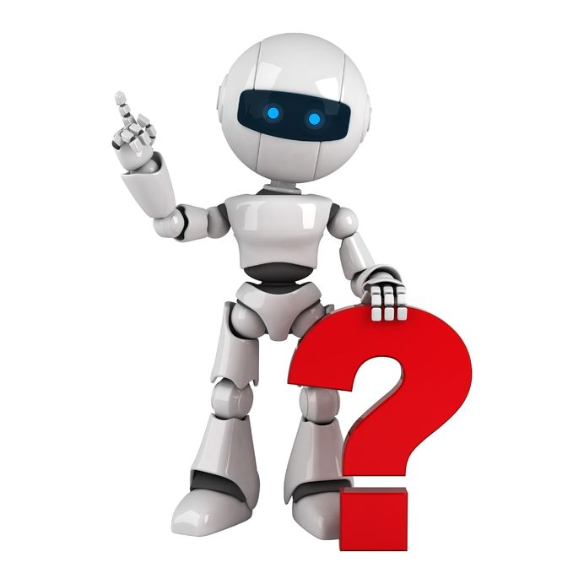

Slide 29


